Slide 1


Investment Theory & Practice—Asset Management
October 2020
Sorting by Trading Volume
Josh Artmann, Sujay Chebbi, Xuxian Chen, Alexandre Nicolai, Khoi Tran
FIN 397—The University of Texas at Austin

Slide 2
Investment Strategy
We are going to create a portfolio consisting of:
200 stocks with highest monthly trading volume
Equally weighted
Rebalance monthly:
Sell previous securities
Buy next month’s securities
Notes:
Sujay

Slide 3
Rationale
Higher trading volume stocks will likely have much higher buying trends versus low volume stocks -> higher buying trends, higher returns.
Efficient market: Market participants will be more attracted to good fundamental companies so when there is a good earnings/good news -> more shares are purchased.
The higher the volume, the tighter the Bid-Ask spread -> less cost incurred.
Notes:
Sujay

Slide 4
Data Pre-Processing
Data Acquisition:
We pulled all historical performances (with volume) from CRSP database for date range 01/01/1985 - 12/31/2019
Data Cleanup:
We created a calculated field called “relative trading volume” by taking the monthly trading volume of a stock and divide it by the total trading volume of all stocks for that month.
Eliminated the bottom 10% of firms by market cap because those volumes were ~ 0.
Split stocks to quartiles based on trading volume.
Notes:
Xuxian: so to talk a little bit about data collection and pre processing.
We started with collect all historical performance, such as trading volume, price, shares outstanding, and adjusting factors, etc. for all the equity in the crsp.
Then we calculated the monthly relative trading volume per stock, which is dividing the monthly trading volume by the market trading volume.
Then we take out the securities in the bottom 10% market cap , retaining only 90% of the data
Form there, we take the percentile based on trading volume.

Slide 5
Findings
High volume quartiles tends to outperform in favorable times.
But in some time generate more losses in market downturns.
Notes:
Xuxian:
What we found, is that the high volume quartiles tends to outperform

Slide 6
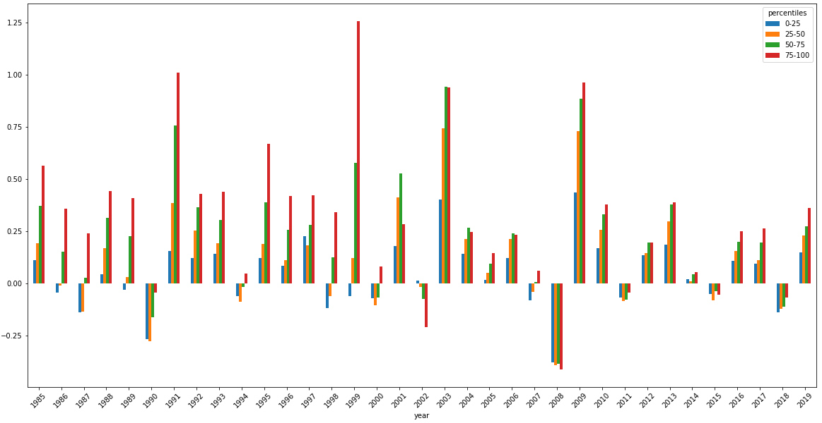
Exploratory & Statistical Proof
Annualized Return Per Year By Trading Volume Percentile
Notes:
Xuxian:
Here, it could be a little hard to see, but we have the lowest trading volume quartile as blue, then orange, then green, and red for the highest trading volume quartile.
And throughout the time horizon, the red generally outperform the others, and even at some recession.
But at some times, the highest trading volume quartile was the worst performing, which is 2002 & 2008 around the bubble.

Slide 7
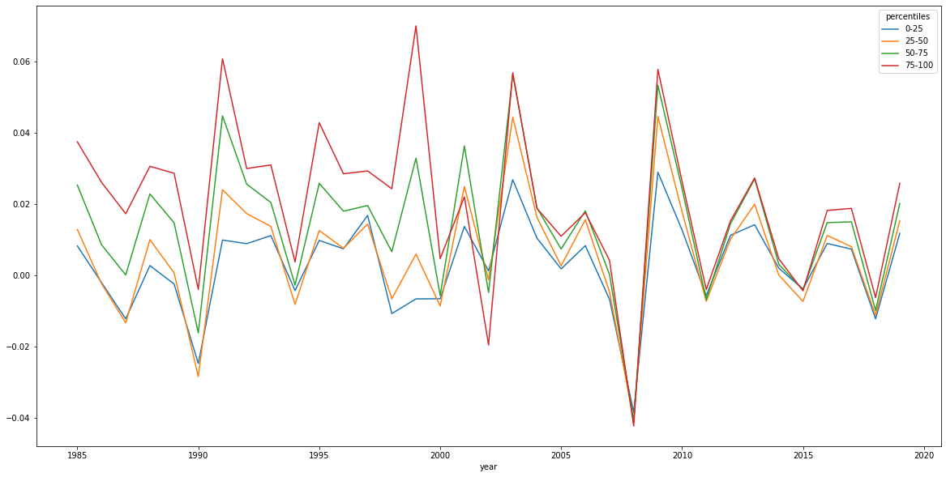
Average Monthly Return Per Year
Notes:
Xuxian:
And here is essentially the same thing as the last one, but it is a line graph. The red line, which is the highest trading volume is somewhat consistently showing higher performance.
Convergences in market downturns ( 1990, 2000, 2008,...)
Divergences in expansions (90s, pre dot-com, recovery after 2008)

Slide 8
Portfolio Backtesting
We created 2 portfolios that consist of the top 200 and the bottom 200 relative trading volume stocks
Notes:
Josh

Slide 9
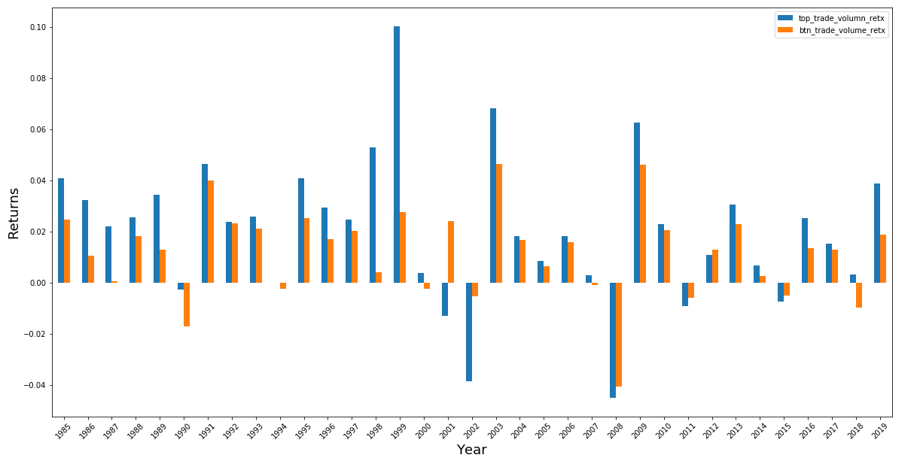
Annualized Return
Notes:
Josh

Slide 10
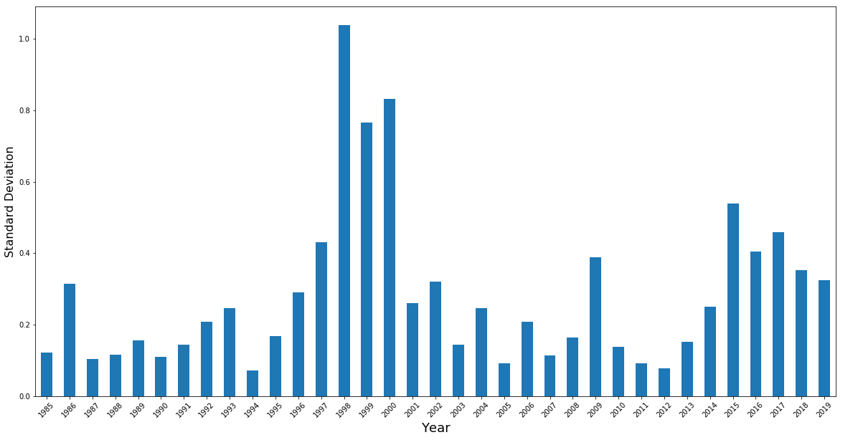
Annualized Standard Deviation
(Top 200 TV)
Notes:
Josh
As prof Sury mentioned, sorting by trading is a double edged sort because you are holding both the stocks that are so good people keep buying them, as well as the stocks so bad people want to get rid of them.
1998-2000 period of high volatility due to tech c

Slide 11
H-Null: The return of the 200 stock with highest trading volume is not statistically significant different from the 200 lowest trading volume stock
H-Null: The return of top 25% trading volume is not statistically significant different from lowest 25% trading volume stocks
((diff['top_trade_volumn_retx'] - diff['btn_trade_volume_retx']).mean()) / (( diff['top_trade_volumn_retx'] - diff['btn_trade_volume_retx']).std()/math.sqrt(len(diff['top_trade_volumn_retx'])))
4.25, Reject !
((percentile_retx['75-100'] - percentile_retx['0-25']).mean() - 0 ) / (( percentile_retx['75-100'] - percentile_retx['0-25']).std()/math.sqrt(len(percentile_retx['75-100'])))
7.686, Reject!
Notes:
Alex

Slide 12
Final Results
Assumptions:
high volume portfolios trading cost of 5 BP
low volume portfolios trading cost of 10 BP
 | Top_200 Portfolio | Btm_200 Portfolio | Difference
Cost of Trading | 5bp * 12 months | 10 bp * 12 months | -
Avg Annual Return | 27.711% | 15.29% | 12.421%
Avg Net Return | 27.111% | 14.29% | 12.821%
Std (Annualized) (DrawDown %) | 27.24% | 18.01%

Slide 13
Shortcomings
Strategy assumes pre-knowledge of stocks with highest trading volume for that month.
Strategy does not hedge against selloffs of low performing stocks in portfolio for each month.
Notes:
Khoi

Slide 14
How To Improve
Research the relationship of high trading volume and momentum factor for better stock selection
Hedge against low performing stocks by dropping security if it falls below mean return for all stocks in portfolio
Add a factor in addition to volume to rebalance each month
Eg. Price to book ratio
Volume alone does not factor in momentum 1000 shares of AMZN vs 1000 shares of BAC)
Build a Predictive model to identify most traded volume stocks. Use relative volume for allocation instead of equally weighted.
Notes:
Khoi

